Slide 1
While folks are joining
Get you laptops ready and login to www.crio.do
Open Qmoney ME and start your workspace.
Open Terminal and type
cd ~/workspace
Clone the repo in ~/workspace directory
git clone git@gitlab.crio.do:bdt-sprint-codes/core-java-i/core-java-i-session-activities.git
Open session-3 folder.
Wait for Java Language Server Setup to complete.
Setup Video for Reference
Notes:
Solution( Not to be shared to users during session ) :- https://gitlab.crio.do/bdt-sprint-codes/core-java-i/core-java-i-session-activities-debrief/session-3.git
Browsable Git: https://gitlab.crio.do/bdt-sprint-codes/core-java-i/core-java-i-session-activities/-/tree/main/session3

Slide 2

Crio Sprint: CORE-JAVA-1
Session 3

Slide 3
Today’s Session Agenda
QMoney Module 2 Debrief
Builder Design Pattern
Java Streams
QMoney Module 3 Introduction (Calculations)

Slide 4
QMoney Module 2 - REST API - Debrief
What did we accomplish?
Get stock quotes from a third-party provider
What Concepts did we learn?
HTTP Protocol
Consume REST API using RestTemplate

Slide 5
QMoney Module 2 - Interview Questions
What is Rest API? How is it different from HTTP?
Why do you need REST APIs? What was the world doing before that?
How did you talk to Tiingo? Did they have any limits to have many API calls you can make in a day? If so, how do you think Tiingo enforces that?
What is curl, Postman? Did you use them? Can you call any API in the world using curl or postman?
What is GET, POST, PUT, DELETE etc; how is REST API related to this? Eg: what is the difference between POST vs PUT?
Notes:
QMoney Interview Questions - BDT - Google Docs

Slide 6
Activity #1 - Student Form
Student has to fill a form for XYZ program. Some of the fields are mandatory and some optional.
Mandatory fields
firstName
lastName
Optional fields
Age, Gender, isGraduate, hasExperience, city, state, isEarning, etc.
Details once filled cannot be changed. ( Immutable Class )
Immutable class is a class which once created, it's contents cannot be changed.
How would you design a class for it ?
Telescoping Constructor Pattern
Overload constructors with multiple parameters and no setters.
b. JavaBean Pattern
What is the issue with the above approaches?
Any better alternative?
Yes. Builder Pattern.
Constructor with mandatory parameters and setters for optional parameters.
Notes:
What is the issue with above approach?
Telescoping Constructor pattern - The problem with this pattern is that once constructors are 4 or 5 parameters long it becomes difficult to remember the required order of the parameters as well as what particular constructor you might want in a given situation.
JavaBeam Pattern - The problem here is that because the object is created over several calls it may be in an inconsistent state partway through its construction. This also requires a lot of extra effort to ensure thread safety.
Credits:- java - When would you use the Builder Pattern? - Stack Overflow Credits:- Builder Design Pattern Java Real World Example | ADevGuide

Slide 7
Steps to Implement Builder Pattern
Make all fields private final
Create inner class Builder having the same number of private fields ( same name recommended) as in outer class.
In Builder class, create
one private constructor for all the required fields
setter methods for optional fields ( must return Builder Object to achieve method chaining. )
Create copy constructor in outer class with Builder as input parameter.
Initialize fields of Outer class with Builder class fields.
Finally, provide a build() in Builder class that will invoke Copy Constructor and will return Outer class object.
A technique of calling multiple methods using dot(.) operator in a single statement.
StringBuilder str = new StringBuilder("java");
str.insert(0,"refresh ").append("tutorial ").append("online");
Notes:
Inner class fields are not required to have the same name as outer class, but it is good practice to keep them same as outer class

Slide 8
Activity #1.1 - Student Form
Implement Student class using Builder Pattern
Object Creation Example. Try this out!
Student student = new Student.StudentBuilder("Pra", "Bhu") // mandatory parameters
.addAge("25") // optional
.addGender("M") // optional
.addHasExperience(true) // optional
.build(); // to get back student option
New Object created is immutable.
What are the advantages of Builder pattern from the above solution?
Maintainable, if number of fields required to create object is more than 4 or 5.
Robust, as only fully constructed object will be available to client.
Immutability of the object once its created.
Notes:
What are the advantages of Builder Pattern?
The parameters to the constructor are reduced and are provided in highly readable method calls.
Builder design pattern also helps in minimizing the number of parameters in constructor and thus there is no need to pass in null for optional parameters to the constructor.
Object is always instantiated in a complete state
Immutable objects can be build without much complex logic in object building process.
Credits:- Builder Design Pattern | Code Pumpkin

Slide 9

Curious Cats
Where is Builder Pattern used in Real world Applications?
Builder pattern is used in javax.json package while building JSON objects.
JsonObjectBuilder b = Json.createObjectBuilder().
add( "report", Json.createObjectBuilder().
add( "reportId", reportId ).
add( "title", title ).
add( "subtitle", subTitle == null ? "" : subTitle ).
add( "created", created.toString() ).
add( "description", description == null ? "" : description ).
add( "data", report )
);
return b.build();
Builder Pattern is too verbose to implement. Any library available for it? 😅
Using Lombok's @Builder Annotation | Baeldung (Will be discussed later!)
Notes:
Credits:- Real-world examples of the Builder pattern - Stack Overflow

Slide 10
Activity #2 - ‘A’ Employees
Given the list of employees, print the list of employees whose name starts with ‘A’
Complete method findNameA() in Main.java
What is the output?
Amit
Let’s try a more sleek version using Java Streams.
public static void findNameAWithStream(){
List<Employee> employeesList = getListOfEmployees();
List<String> employeeNames = employeesList.stream()
.map(e -> e.getName())
.filter(s -> s.startsWith("A"))
.collect(Collectors.toList());
System.out.println(employeeNames);
}
How do you feel about this code?
Less Verbose
More Intuitive

Slide 11
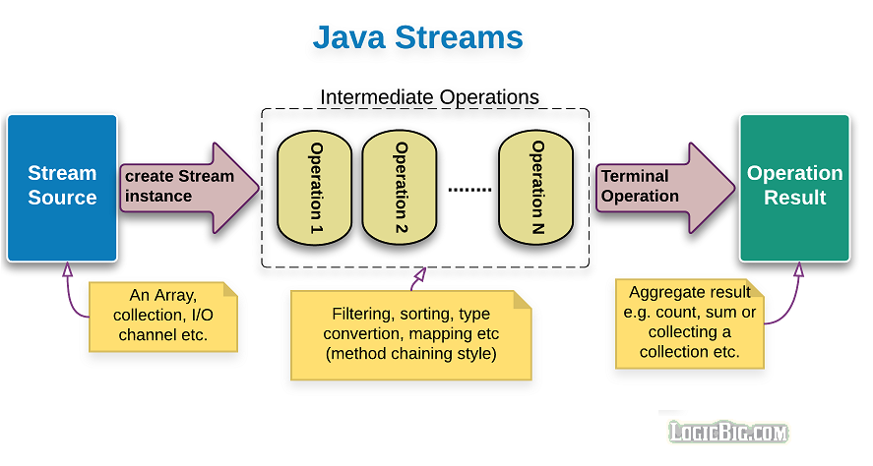
Java Streams API

Slide 12
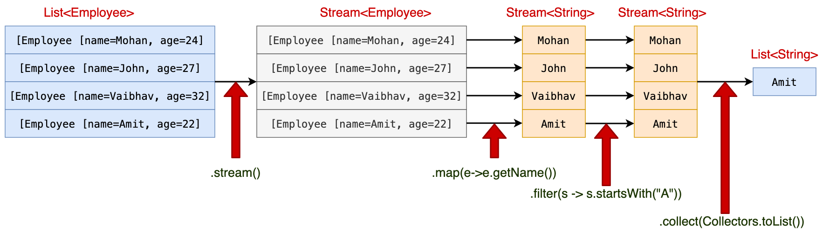
Activity #2 - ‘A’ Employees (Java Streams: Pipeline)
Stream pipeline consists of:
Source
Zero or more intermediate operations
Terminal operation
Lambda Expression
Intermediate Operation
Terminal Operation
Notes:
Credits:- https://java2blog.com/java-8-stream/

Slide 13
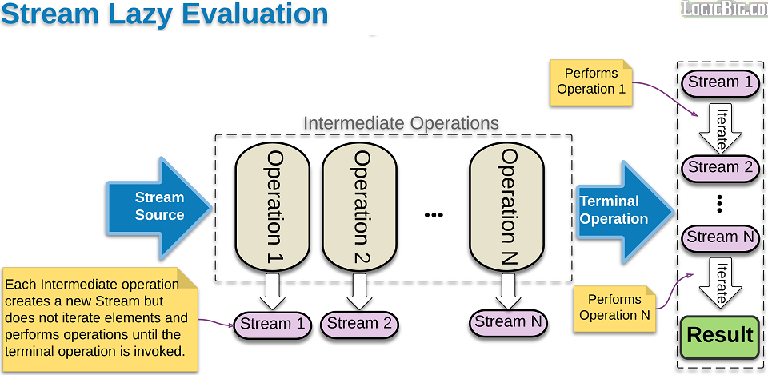
Activity #3 - Java Streams: Lazy & Order
Intermediate operation are not executed until terminal operation is encountered.
Try it out on Workspace
How stream processes the order of operations?
Try it out on Workspace
Notes:
Each intermediate operation generates a new stream, stores the provided operation or function. When terminal operation is invoked, stream pipeline execution starts and all the intermediate operations are executed one by one.
How stream processes the order of operations?
A common approach will be to perform intermediate operation on all elements and then perform next operation, but instead each element moves vertically.
This kind of behavior can reduce actual number of operation.
Some of the intermediate operations such as sorted are executed on the entire collection. As succeeding operations might depend on the result of sorted operation.

Slide 14
Stream Creation Techniques
Empty Stream
Stream s = Stream.empty()
Collection Stream
Stream can be created from Collection by calling .stream() or .parallelStream()
Arrays.asList("Andy","Peter","Amy","Mary").stream()
Stream.of()
Stream streamArray =Stream.of("X","Y","Z");
Other less commonly used
Stream.generate()
Stream.iterate()

Slide 15
Common Intermediate Operations
map()
convert Stream<T> to Stream<R>. It produces one output result of type 'R' for each input value of type 'T'.
filter()
filter stream based on conditions.
sorted()
sort list of objects.
limit()
limit the number of elements in the stream.
skip()
discard first n elements from the stream.
And many more

Slide 16
Common Terminal Operations
forEach()
iterate over collection/stream of objects and perform custom operations.
collect()
collect the stream elements to a collection.
count()
returns count of elements in the stream.
min()
returns minimum element in the stream based on the provided comparator.
max()
returns maximum element in the stream based on the provided comparator.
And many more

Slide 17
Activity #4 - Java Streams: Query Practice
Given the list of employees, find the count of employees with age greater than 25?
Given a list of employees, you need to sort employee list by age?
Given a list of employees, find out all the employees whose designation is “Manager” and age is above 30.
Notes:
Credits:- A In-Depth guide to Java 8 Stream API - Java2Blog
Java 8 filter method with Example | Java 8 Stream API (codedestine.com)
Given the list of employees, find the count of employees with age greater than 25?
List<Employee> employeeList = createEmployeeList();
long count = employeeList.stream()
.filter(e->e.getAge()>25)
.count();
System.out.println("Number of employees with age 25 are : "+count);
Given a list of employees, you need sort employee list by age?
List<Employee> employeesList = createEmployeeList();
List<Employee> sortedList = employeesList.stream()
.sorted((e1,e2)->e1.getAge()-e2.getAge())
.collect(Collectors.toList());
sortedList.forEach(System.out::println);
Given a list of employees, find out all the employees whose designation is “Manager” and age is above 30.
List<Employee> tempList = empList.stream()
.filter(e -> "Manager".equalsIgnoreCase(e.getDesignation()) && e.getAge() > 30)
.collect(Collectors.toList());
tempList.forEach(e -> System.out.println("Designation :- " + e.getDesignation() + " , Age :- " + e.getAge()));

Slide 18
Additional Practice - ( Try at home on Workspace )
Solving Real Time Queries Using Java 8 Features -Employee Management System (javaconceptoftheday.com)
Notes:
Skip this slide.

Slide 19
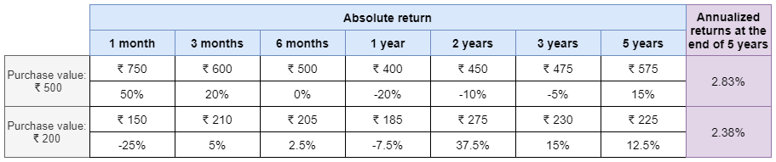
QMoney Module 3 - Calculations
Absolute Return
Total Gains or losses since the purchase of a particular stock.
Annualized return
amount of money the investment has earned for the investor per annum.
In this module,
Implement a mathematical formula to calculate annualized returns.
Use the formula to calculate the performance of stocks using real data.

Slide 20
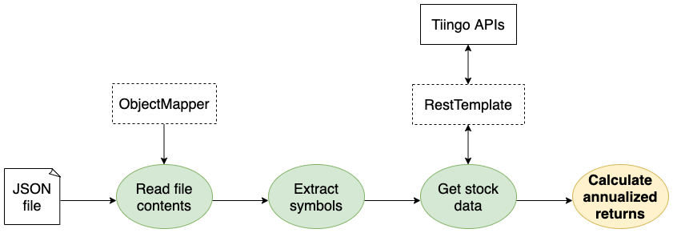
QMoney Module 3 Overview - Calculations
Notes:
The following preliminary requisite steps to compute a stock’s annualized returns are completed:
Read a trade data file to retrieve information like symbol, quantity, trade type, and purchase date.
Call Tiingo to fetch the closing price of stocks on a particular day.
With this information, you can now proceed to compute the performance of a stock over a period of time. Portfolio managers will use this data to analyze trades and make investment recommendations for their clients.

Slide 21
QMoney Module 3 - Files to be modified
PortfolioManagerApplication.java
Notes:
TODOs in the code indicates what to be implemented.

Slide 22
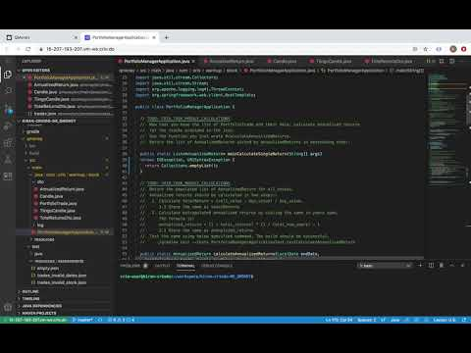
QMoney Module 3 - Intro Video

Slide 23
Take home exercises for the session
JUnit (crio.do)
QMoney Module -3 : Calculations

Slide 24
Feedback
Thank you for joining in today.
We’d love to hear your thoughts and feedback - Feedback for CORE-JAVA-1 Session

Slide 25
Further Reading
What is the use of private constructor in java? | Code Pumpkin
Understanding Java Streams – The Bored Dev
Top 40 Java 8 Interview Questions & Answers [Most Important] (softwaretestinghelp.com)
Handling collections as streams - Java Programming (mooc.fi)

Slide 26
References
java - When would you use the Builder Pattern? - Stack Overflow
Builder Design Pattern | Code Pumpkin
Real-world examples of the Builder pattern - Stack Overflow
A In-Depth guide to Java 8 Stream API - Java2Blog
Java 8 Stream operations cheat sheet (logicbig.com)

Slide 27
Thank you

